Slide 1
Air Pollution:
The Chokehold on China
Time Series Forecasting Analysis
OPIM 5671: Group 9
Notes:
Steph

Slide 2
Presentation Overview
Business
Case
Dataset Utilization
Model Development
Model Evaluation
Conclusion
The motivation and problem being solved
An overview of dataset and cleaning process
Approach to building models
Approach to evaluating best model
Proposal to policymakers
Key takeaways included on each slide
Notes:
Steph

Slide 3
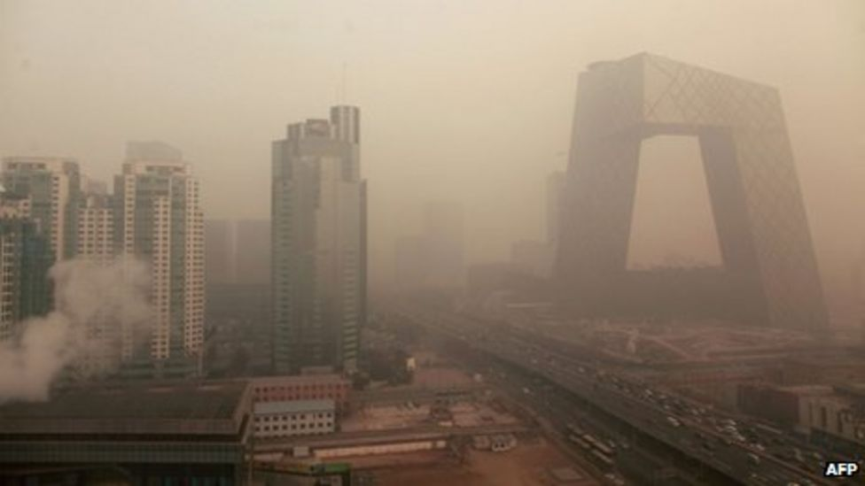
A Concern Worth Exploring
Business
Case
Data
Dev
Eval
Concl.
FACTS TO CONSIDER
2 million deaths per year (WHO)
Leads world in clean energy (IQ Air)
High interest of policymakers
“What is the expected concentration of air pollution in China in 2015?”
Notes:
Steph
World Health Organization
5 Surprising facts about the air quality in China (iqair.com)

Slide 4
Dataset Discovery
Business
Case
Data
Dev
Eval
Concl.
OVERVIEW OF DATASET
Credible source
43K rows of hourly data
12 weather-related variables
Hourly data was first converted to daily then to monthly using accumulation functions
INITIAL OBSERVATIONS
Seasonality: No
Stationary: Yes
Trend: No
Notes:
Arun

Slide 5
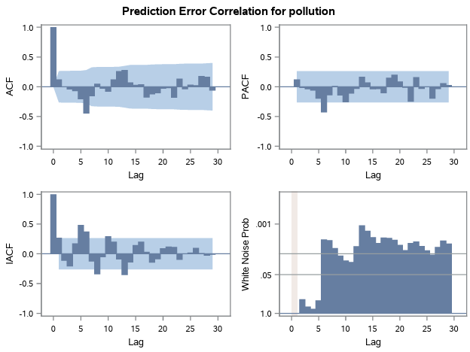
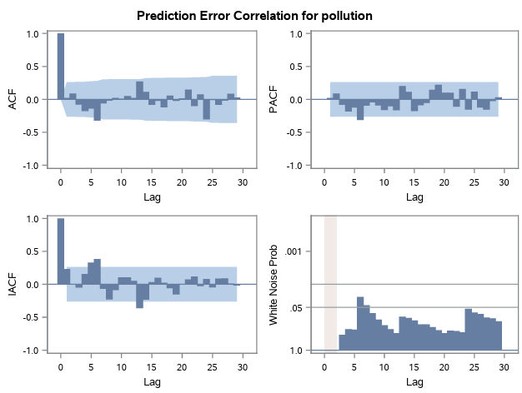
Model Development
Business
Case
Data
Dev
Eval
Concl.
SIMPLE EXPONENTIAL
ADDITIVE SEASONAL EXPONENTIAL
There remains opportunity to further improve the model based on the White Noise Test
Notes:
Madhavi

Slide 6
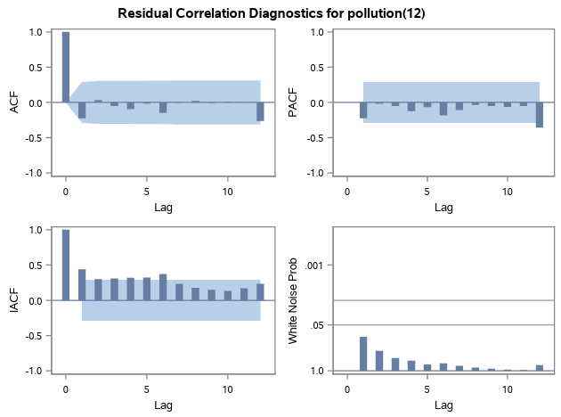
Model Development
Business
Case
Data
Dev
Eval
Concl.
SEASONAL ARIMA
Promising model passes White Noise Test; Opportunity to prewhiten
Notes:
Madhavi

Slide 7
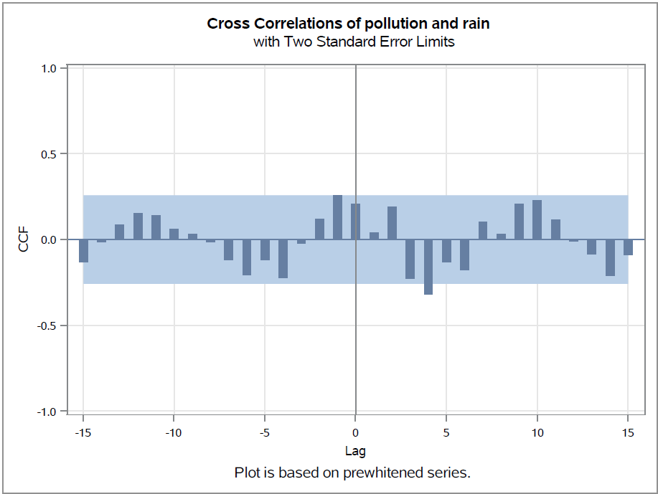
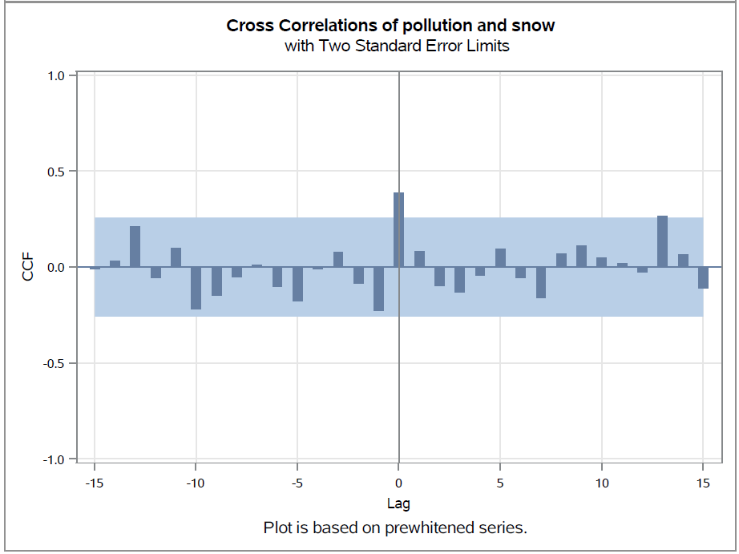
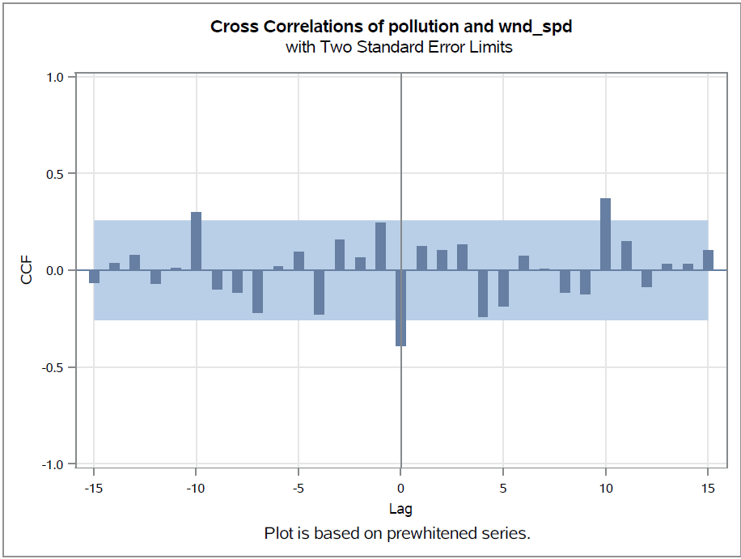
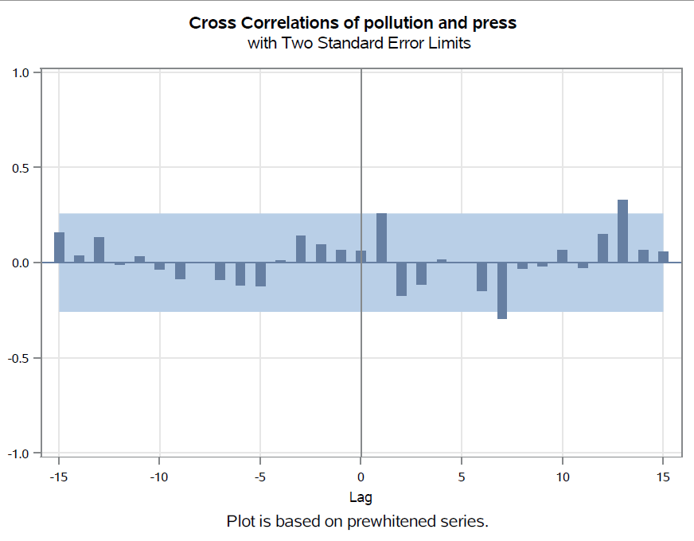
Pre-Whitening for ARIMAX
Business
Case
Data
Dev
Eval
Concl.
RAIN HAS LAG(4), PRESSURE HAS LAG(1), WIND SPEED AND SNOW HAVE LAG(0)
Notes:
Steeven

Slide 8
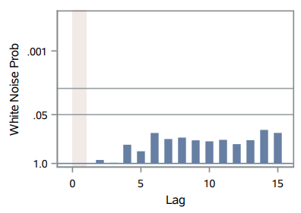
Model Evaluation
Business
Case
Data
Dev
Eval
Concl.
ARIMAX(1,0,0)
White Noise Prob
Model | AIC | SBC | MAPE | ACCURACY
ARIMA(0,0,0)(0,1,0)S | 472.51 | 474.38 | 29.89% | 70.11%
ARIMAX(0,0,0) | 507.18 | 517.31 | 20.01% | 79.99%
ARIMAX(1,0,0) | 508.05 | 520.20 | 19.86% | 80.14%
ARIMAX(1,0,1) | 507.27 | 521.44 | 20.09% | 79.91%
ARIMAX(2,0,1) | 508.97 | 525.18 | 20.75% | 79.25%
ARIMAX(1,0,0) IS THE FINAL MODEL SELECTED
Notes:
Steeven
We didn't put other models on the table is because they didn't pass the white noise test.

Slide 9
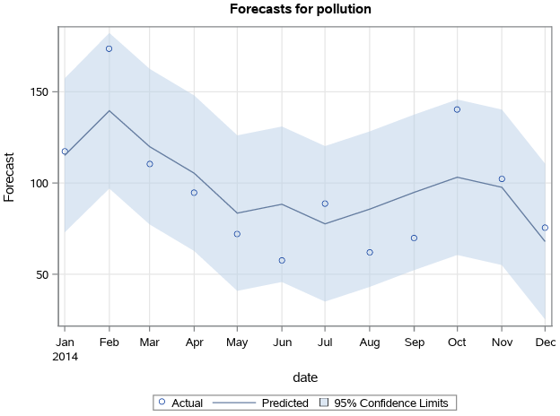
Pollution Campaigns for Policymakers
Business
Case
Data
Dev
Eval
Concl.
POLICYMAKERS SHOULD DEVELOP ANTI-POLLUTION CAMPAIGNS LEADING INTO Q1 AND THE FALL SEASON
Notes:
Divyam

Slide 10
Resources
Kaggle: Access to air pollution data
World Health Organization: Information about impact of air pollution on China
US Environmental Protection Agency: Education about how air pollution is measured
Link to our work: Github repository which contains all the files
Notes:
Divyam

Slide 11
Thank You

